Slide 1
Support Vector Machine (SVM)
A Support Vector Machine (SVM) is a supervised machine learning algorithm that can be used for classification or regression tasks.
It's a type of discriminative classifier that works by finding the hyperplane that best divides a dataset into different classes.

Slide 2
key concepts associated with Support Vector Machines
Hyperplane.
Support Vectors.
Margin.
Kernel Trick.

Slide 3
key concepts associated with Support Vector Machines
Hyperplane:
A hyperplane is a boundary that separates the data from low dimension to high dimension i.e. from 2D to 3D into two classes.
In a two-dimensional space it’s a line, in three dimensions, it's a plane, and so on.
The goal of SVM is to find the hyperplane that best separates the data into different classes.

Slide 4
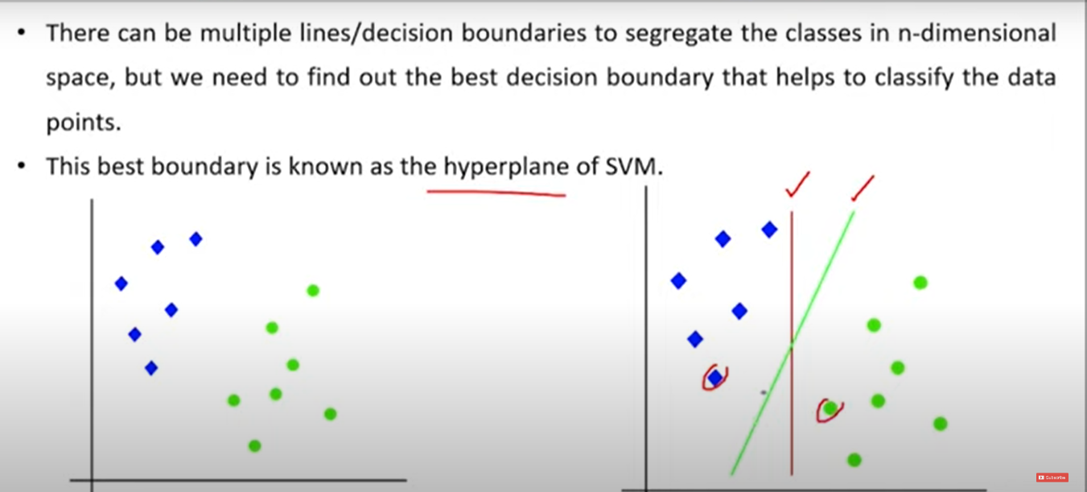
Hyperplane

Slide 5
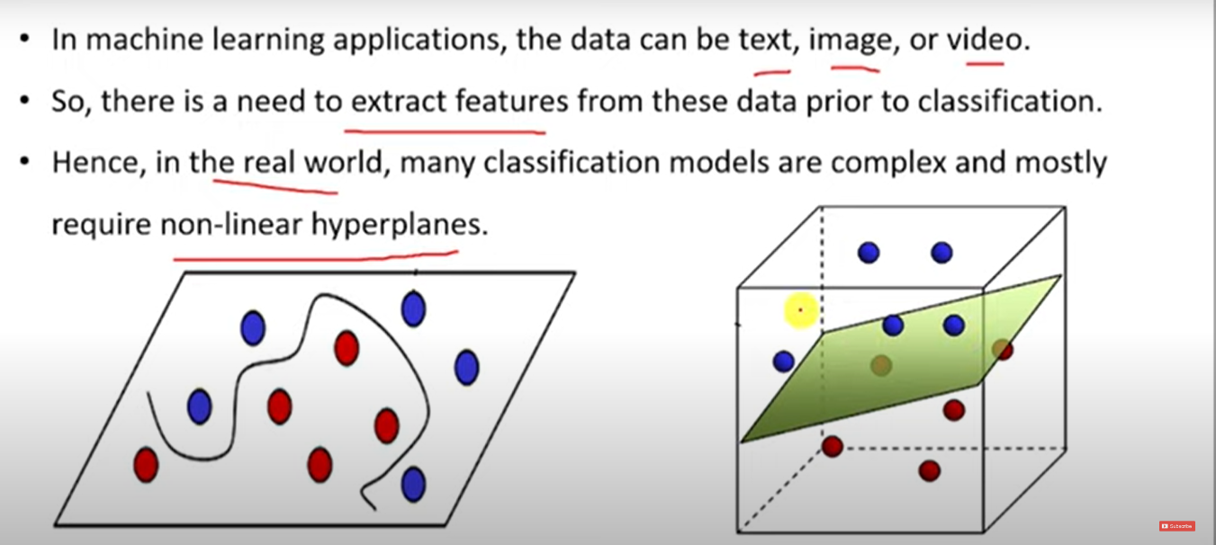

Slide 6
key concepts associated with Support Vector Machines
Support Vectors: Support vectors are the data points that are closest to the hyperplane and have the most influence on its position. These are the critical elements in determining the optimal hyperplane.
Margin: The margin is the distance between the hyperplane and the nearest data point from each class. SVM aims to maximize this margin because a larger margin generally leads to better generalization to unseen data.

Slide 7
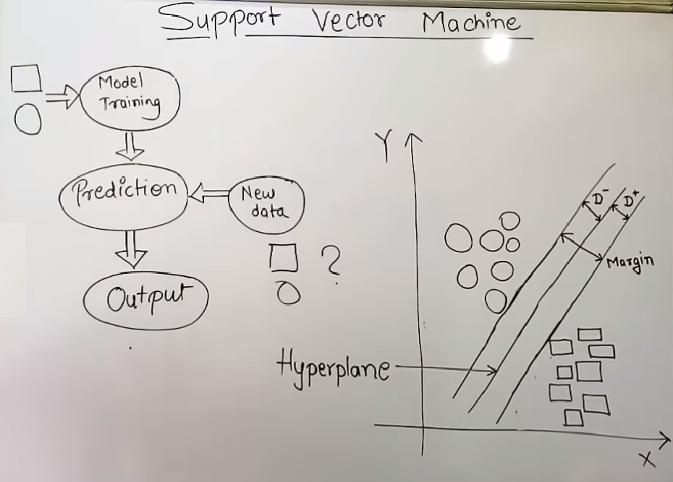
https://www.youtube.com/watch?v=eNyUfpGBLts
https://www.youtube.com/watch?v=xLkk6MUrvrw&t=3s

Slide 8
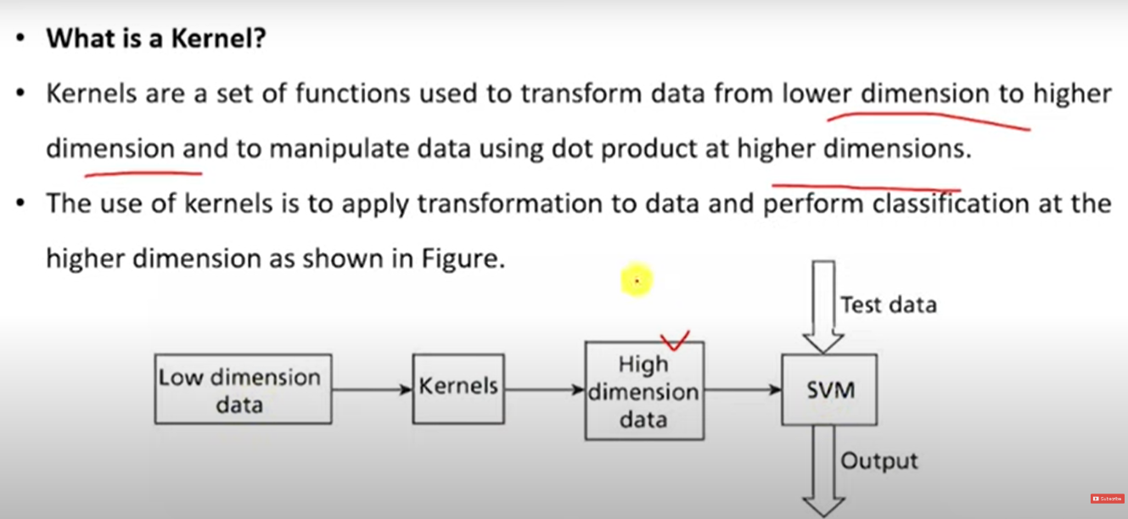
Kernel

Slide 9
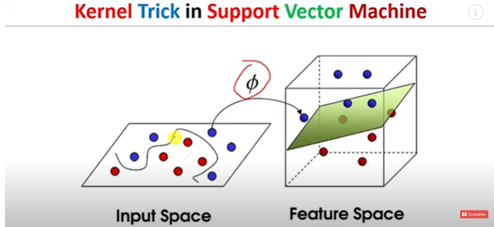

Slide 10
Kernel Trick
Kernel Trick: SVM can handle non-linear decision boundaries through the use of the kernel trick. Kernels allow SVM to implicitly map the input data into higher-dimensional feature spaces, making it possible to find a linear decision boundary in that space.

Slide 11
Types of SVM
Linear SVM: Works well when the data is linearly separable.
Non-linear SVM: Utilizes the kernel trick to handle non-linear decision boundaries.

Slide 12
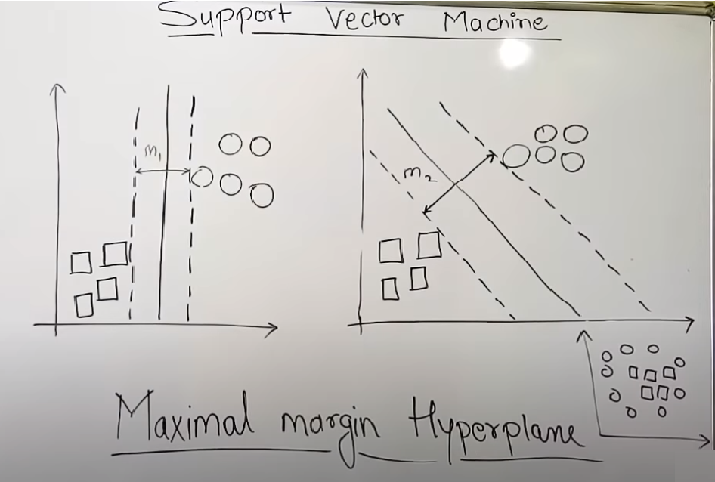
https://www.youtube.com/watch?v=0MJTaPoHv-g

Slide 13
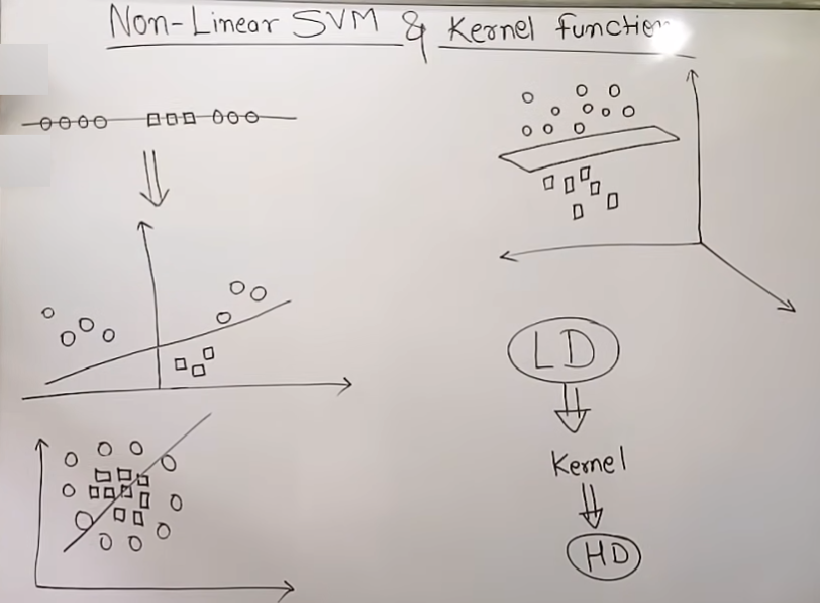
https://www.youtube.com/watch?v=owsAQ_fiwIw

